Slide 1
Covid-19 Global Trend

Slide 2
Introduction:
The project examines global coronavirus trends using descriptive and visual analysis. I found the data set at the website below, which is available to the public: Our World in Data - COVID-19 | Kaggle
This dataset includes data on all country’s cases of covid diseases as well as additional specific information about the number of cases, deaths, vaccines, and other factors. And this dataset has 228993 records and 33 columns.

Slide 3
Problem statements :
Developer : Koyya Venu Sai Ram
1)To determine the number of days in each continent without cases and with cases?
2) How much of the world's population was affected by the coronavirus, and what percentage of people died as a result?
Developer : Pokuri Satyavardhan
3)Which year had the most COVID cases on each continent?
4)Which year had the most COVID deaths on each continent?
Developer: Vakkalagadda Deva Sai Vikas
5)Which month had the most COVID cases on each continent?
6)Which month had the most COVID deaths on each continent?
Developer : Chaudhari Keval Vinubhai
7)Determine how many people on each continent are fully vaccinated?
8)Determine how many people on each continent are Partially vaccinated

Slide 4
Core Components:
Language:
Python ,Pandas
Executing the script:
colab
Notebook Link : https://colab.research.google.com/drive/1SLPGVm3zvNUMmagx3n5G45k9WRc_vxk9?usp=sharing

Slide 5
Data Transformation:
Raw Covid-19 Dataset
Preprocessing Data
Data cleaning
Applied Functions to extract output for problem statement
Visualization
Covid Dataset : 228993 records with 33 columns

Slide 6
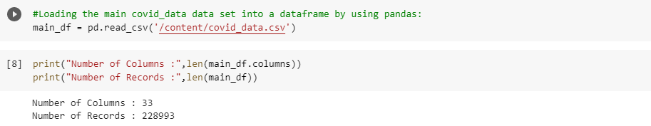
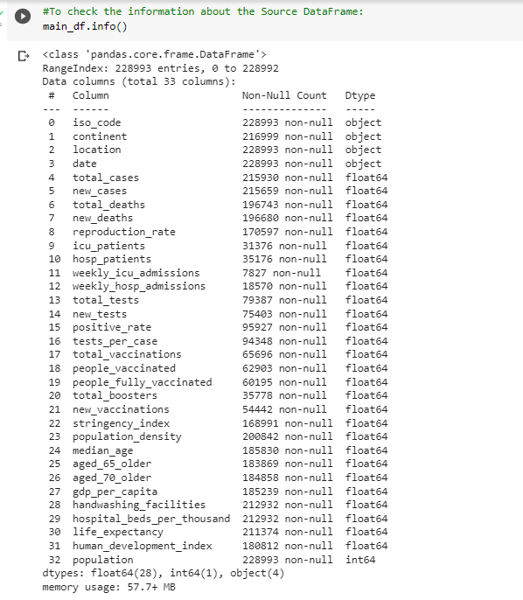

Slide 7
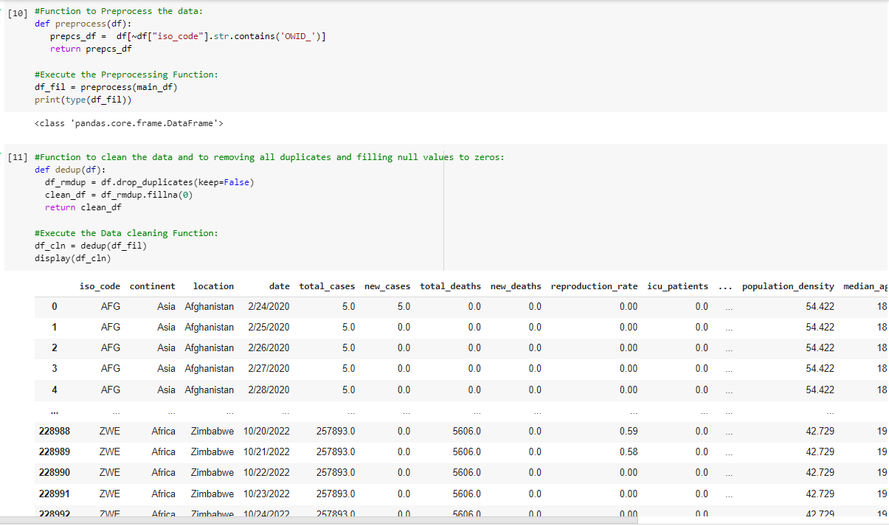

Slide 8
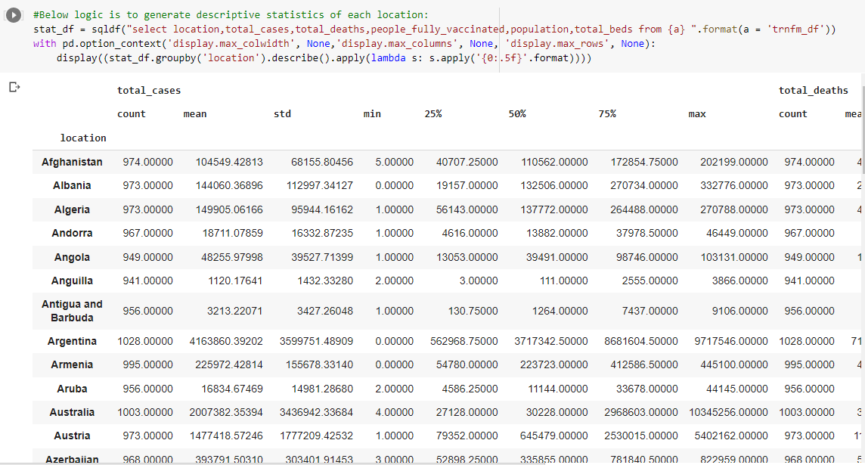

Slide 9
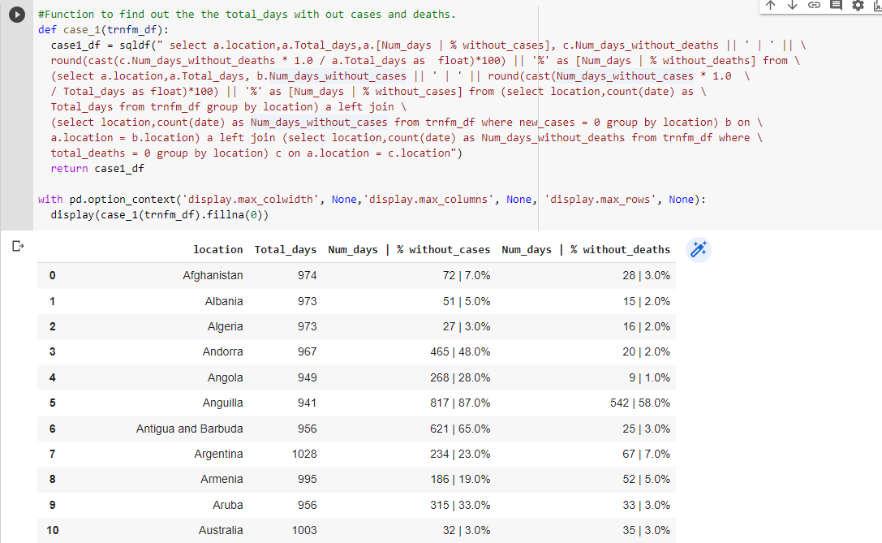
Problem statement -1:To determine the number of days in each continent without cases and with cases.

Slide 10
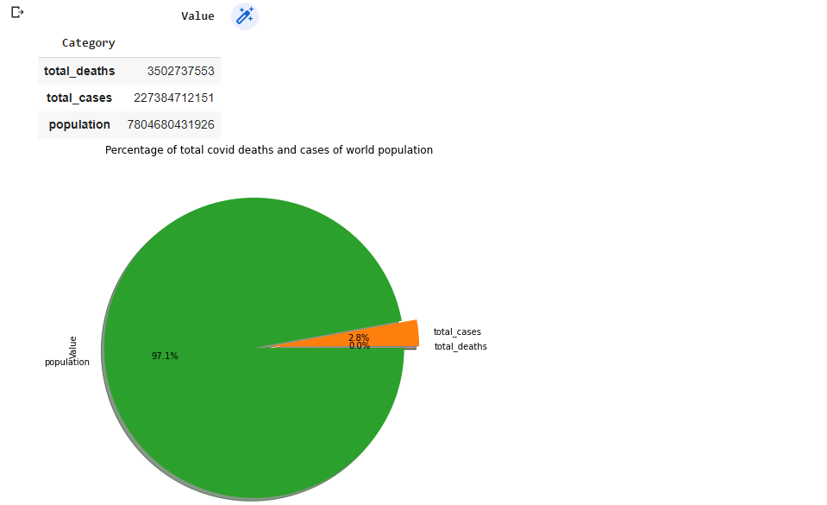
Problem statement -2: How much of the world's population was affected by the coronavirus, and what percentage of people died as a result.

Slide 11
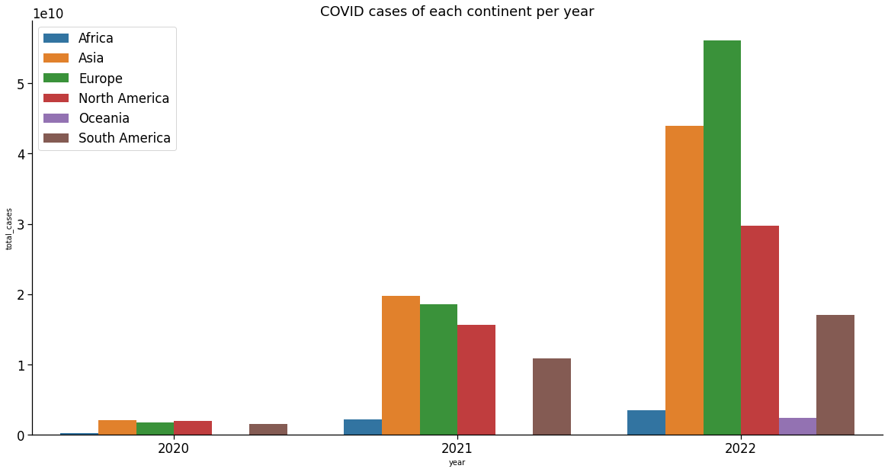
Problem statement - 3 : Which year had the most COVID cases on each continent.

Slide 12
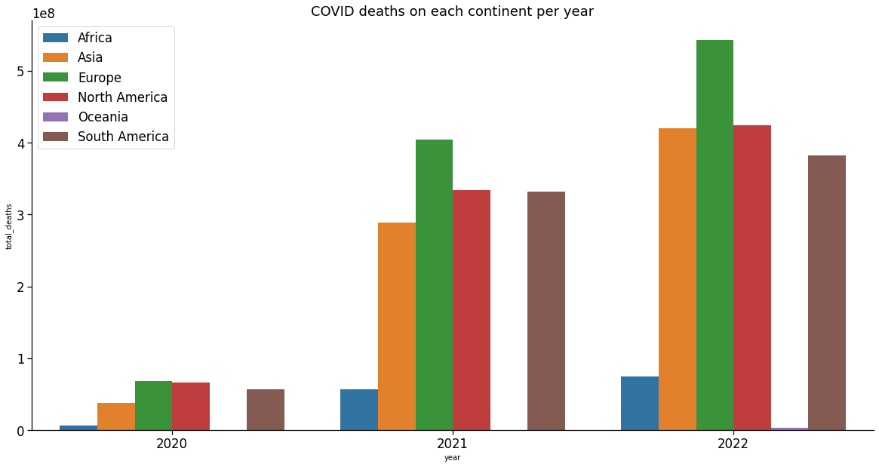
Problem statement - 4: Which year had the most COVID deaths on each continent.

Slide 13
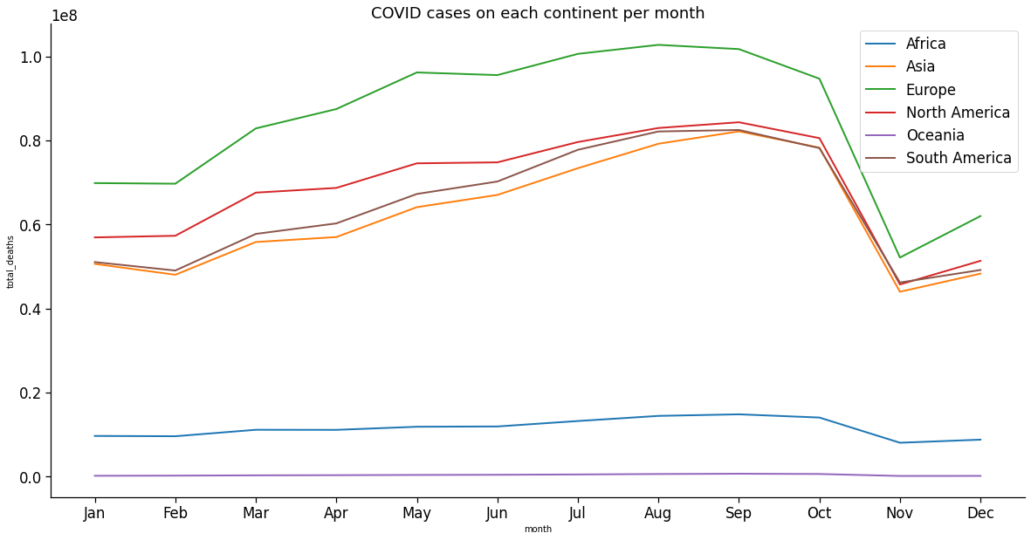
Problem statement - 5: Which month had the most COVID cases on each continent.

Slide 14
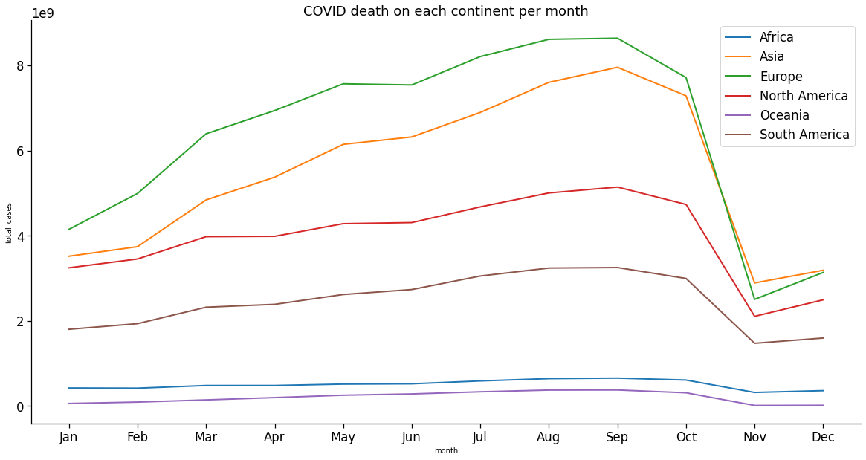
Problem statement - 6: Which month had the most COVID deaths on each continent.

Slide 15
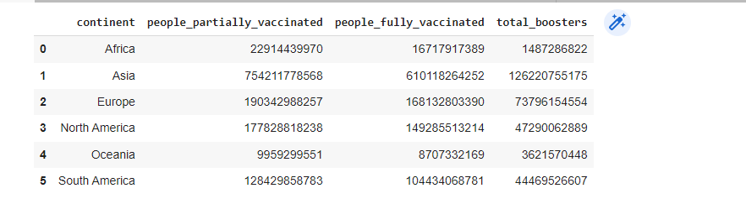
Problem statement - 7 : Determine how many people on each continent are fully vaccinated.

Slide 16
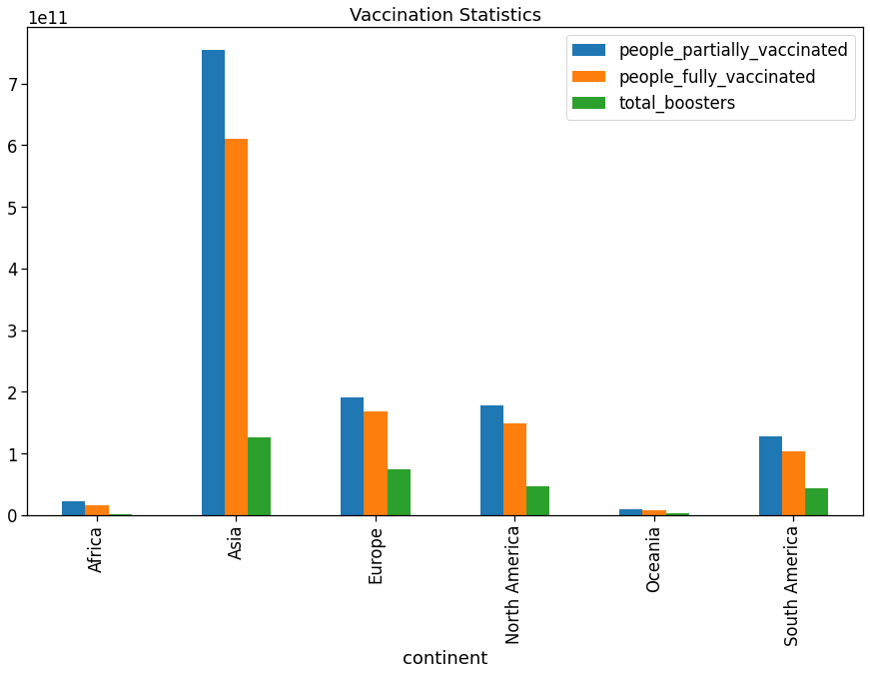

Slide 17
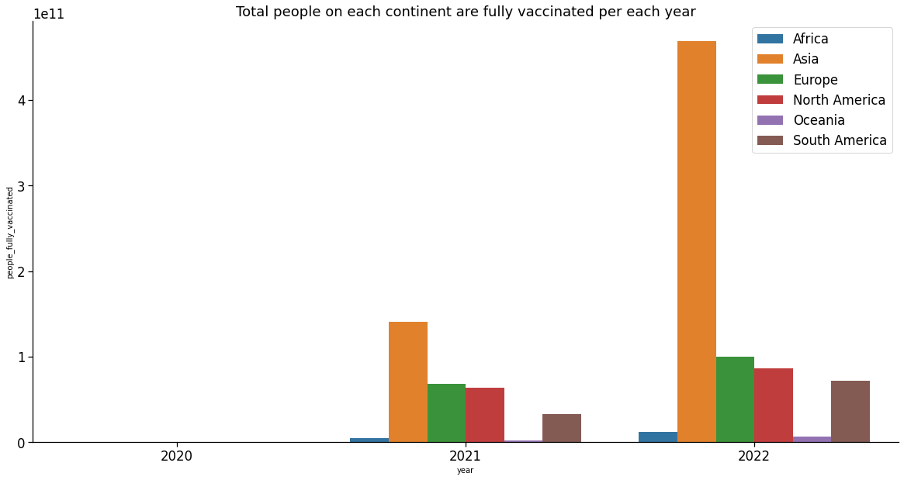

Slide 18
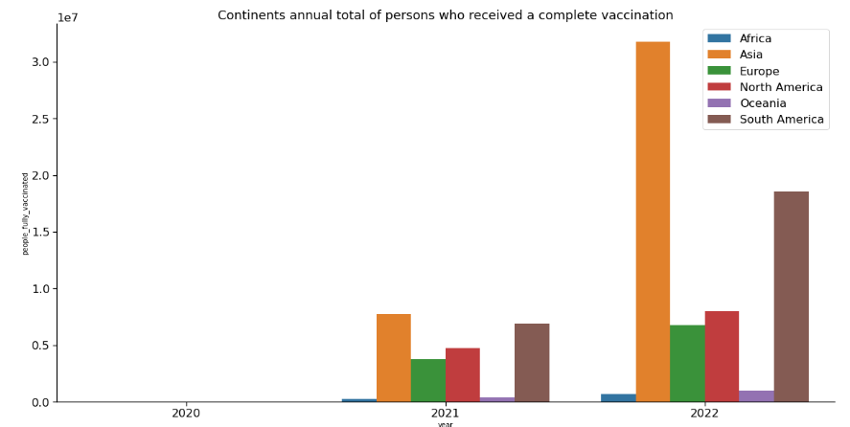

Slide 19
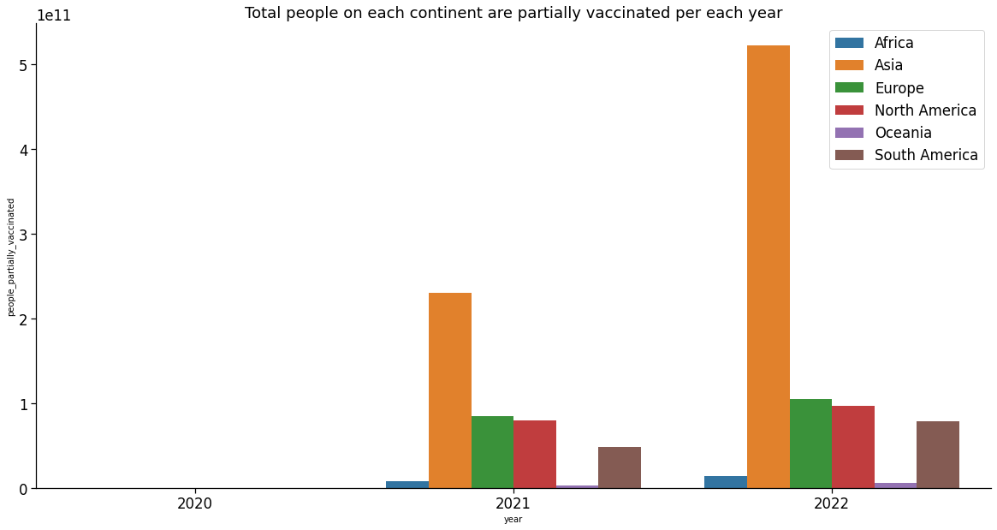
Problem statement - 8:Determine how many people on each continent are Partially vaccinated.

Slide 20
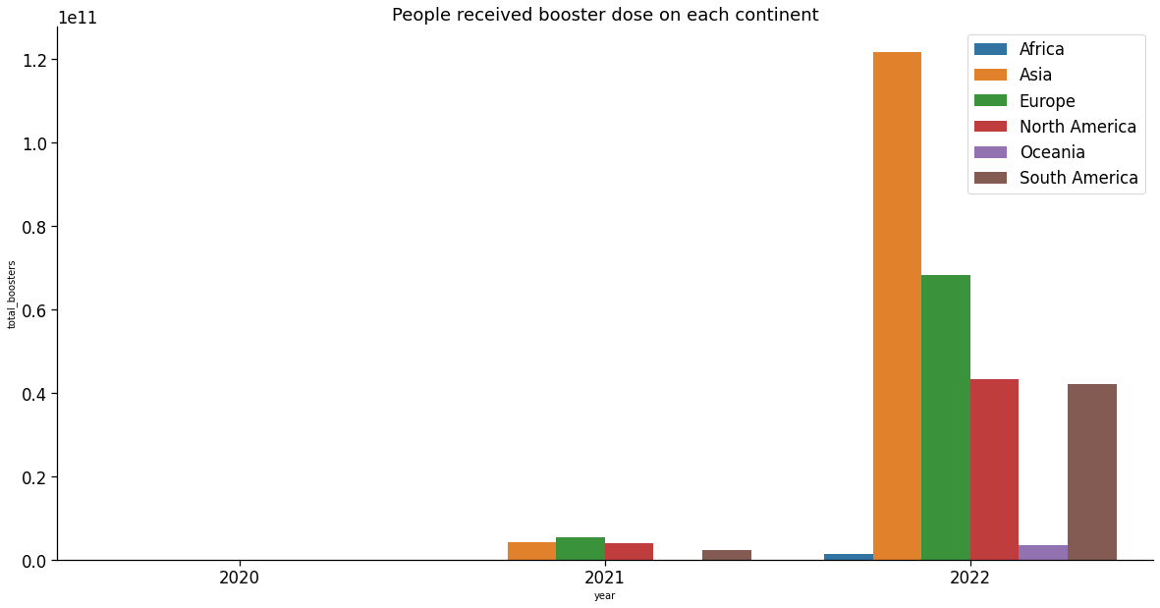
Problem statement - 9:Determine how many people on each continent had a Booster dose.

Slide 21
Thank You

